Slide 1

Increase overall sales of the company on that thesis find the growth of company for next one year
RITU KUMARI
Roll No: COE15B032
Indian Institute of Information Technology
Design and Manufacturing, Kancheepuram, India
B.Tech Project Guide: Dr.N.Sadagopan
17 october 2018

Slide 2
Introduction
.
Sales prediction is a must famous problem in the industry, where company wants to know about their sales that how to increase the over all sales and after few years what will be the condition of the company.
Sales Forecasting is the process of estimating what business’s sales are going to be in the future. A sales forecast period can be monthly, quarterly, half-annually, or annually.

Slide 3
Introduction
Sale forecasting is an integral part of business management. The purpose of sales forecasting is to provide information that we can use to make intelligent business decisions.
Sales forecasting is the process of estimating future sales. Accurate sales forecasts enable companies to make informed business decisions and predict short-term and long-term performance. Companies can base their forecasts on past sales data, industry-wide comparisons, and economic trends.

Slide 4
Introduction
Sales forecasting allows companies to
1.Predict achievable sales revenue.
2.Efficiently allocate resources.
3.Plan for future growth.
Salas prediction is categorized in forecasting problem in data mining. It increases with time

Slide 5
Introduction
Forecasting is determining what is going to happen in the future by analyzing what happened in the past and what is going on now. It is a planning tool that helps business people in their attempts to cope with the uncertainty of what will might and might not occur.

Slide 6
Our Contribution
Data cleaning
Hypothesis generation
Find useful attributes
Create a new attributes if required
Find suitable data mining algorithm for the given data and use it.
Compare overall result and find out a best result.

Slide 7
Data cleaning
Find missing value in the data set
Missing data can have a severe impact on building predictive models because the missing values might be contain some vital information which could help in making better predictions.

Slide 8
Method to fill missing value
create small subset of the given data. From that data, delete manually few value and try to impute that value with multiple method like KNN imputation, central statistics and Prediction method, then compare that all the predicted value with the actual value and see which one is closer, then choose that method as best method.

Slide 9
Method to fill missing value
central statistics
For continuous variable
1.Mean
2.Median
For categorical variables
3.Mode Imputation

Slide 10
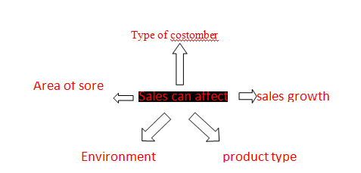
Hypothesis generation

Slide 11
Create new attributes and drop some attributes
Created new features which help in improving the model’s performance and with finding correlation between two data set drop some of the attributes.
Like two attributes are giving same in information so no need to carry both of them, I have to choose one of attributes.

Slide 12
chi-square test
Chi-squared is a means of statistically evaluating data.
It is used when categorical data from a sampling are being compared to expected or "true" results
I get low value for chi-square means there was a high correlation between our two sets of data

Slide 13
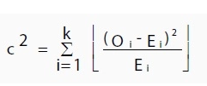
chi-square test
Where O is the observed value, E is the expected value and “i” is the “ith” position in the contingency table

Slide 14
Hypothesis testing with these algorithms
1.Decision Trees
2. Error Metrics
3. Random Forest
4. Linear Regression
5. Logistic Regression
6. Visualizations
7. Time series Analysis
1. XGBoost
2. ARIMA models
3. Box-Jenkins multivariate models

Slide 15

1.Decision Trees
I used Decision Trees for select my attributes. I had branching type of attribute like witch type of family will buy more
• IG = Entropy of the system before split – Entropy of the system after split
• Entropy: Uncertainty in the data/Measure of impurity
Selects the variable whose Information gain (GI)is high

Slide 16
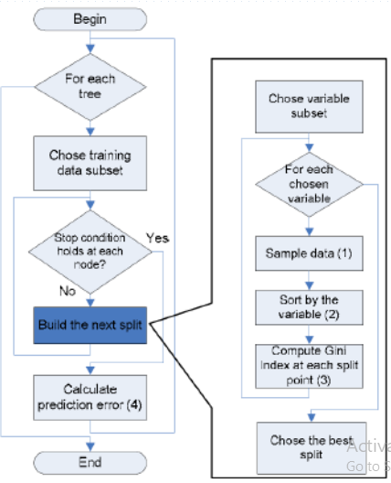
Algorithm Flow chart using random forest

Slide 17
Random Forest
my_control = trainControl(method="cv", number=10) # 5-fold CV tgrid = expand.grid( .mtry = c(3:10),
.splitrule = "variance",
.min.node.size = c(10,15,20) )
rf_mod = train(x = train[, -c("Item_Identifier","Item_Outlet_Sales")],
y = train$Item_Outlet_Sales,
method='ranger', trControl= my_control, tuneGrid = tgrid, no.trees = 500, importance = "permutation")

Slide 18
Linear Regression
5-fold cross validation
linear_reg_mod = lm(Item_Outlet_Sales ~ ., data = train[,c(“target variable")])
# preparing dataframe and writing it in a csv file
Item_Outlet_Sales = predict(linear_reg_mod, test[,c(" target variable ")])

Slide 19
Random Forest
I used Random Forest for my categorical data like example
X1 type of family in y1 type of session from Z1 type of store
Will buy p1 type of item or not

Slide 20
ARIMA models
I used this model for time series analysis where I had to find company condition in next one year.
How did I used it
It has three ordered parameters (p,d,q).
p is the order of the autoregressive model(number of time lags)
d is the degree of differencing(number of times the data have had past values subtracted)
q is the order of moving average model

Slide 21
Box-Jenkins multivariate models
I had to forecast the value for next one year that is time series.
Their was seasonality significant so I used this model
The first step in developing a Box–Jenkins

Slide 22
Visualizations
It is the transformation, selection and representation of data or experiment
I used visualization many time like comparsion between algorithms witch having high performance , compaire hypothesis with target variable “they are affecting or not” data detection etc.
Type of Visualizations
Category wise Distribution, Histogram etc.

Slide 23
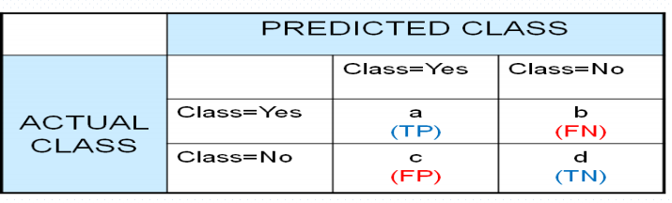
Error Metrics
For check my model accuracy I used error matrix for each model
Accuracy = TP+TN/ Total observations

Slide 24
conclusion
Here I found best results from random forest there is sales increase 65% to 89%.

Slide 25
2nd part
Problem-> find the company condition in next one year
For this part of problem I used ARIMA models and Box-Jenkins multivariate models
Witch one describe in previous slides.

Slide 26
conclusion
After got value of predicted data that increased by 65% to 89% I had to find out forecasting value.
For this problem I use linear regression algorithm as well as Time series analysis.
Time series analysis gave better result than linear regression.
From unpredicted data, company was increasing only 12% sales in next one year but according to predicted data it will be increase 36.446%.

Slide 27
Future work
I used existing algorithm for this particular data and get 89% accuracy. Someone who want to do work in future then they can create different hypothesis on that basis they can also create new algorithm. I got 89% accuracy they can improve it more than this.
Thank you!!

